Slide 1
A Seminar on Towards Efficient Cryptographic Data Validation Service in Edge Computing
Team Details
E. Harsha Reddy(20EG105312)
G. Santhosh Kumar(20EG105315)
R. Sai Krishna(20EG105330)
Project Supervisor
Mrs. P. Aparna
Assistant professor

Slide 2
Introduction
Edge computing brings data computation and storage closer to the mobile device to save response time for decision making. After being processed at the edge, commonly the data will be uploaded to the cloud for further enriched analysis. For privacy concerns, local devices may encrypt the collected data before sending it to the cloud server. However, this treatment increases the server’s processing time and makes it hard to pick out the desired data.we design an encrypted data validation scheme, which enables the edge to clean the encrypted data to be uploaded. Because edge computing encompasses numerous edge devices from different service providers, we explore the public-key cryptographic mechanism to implement our secure data validation scheme. Particularly, compared to prior work, nearly 123-238 speed up is achieved in our key derivation procedure and the storage cost of the secret key is reduced from 547MB to 1.7MB.

Slide 3
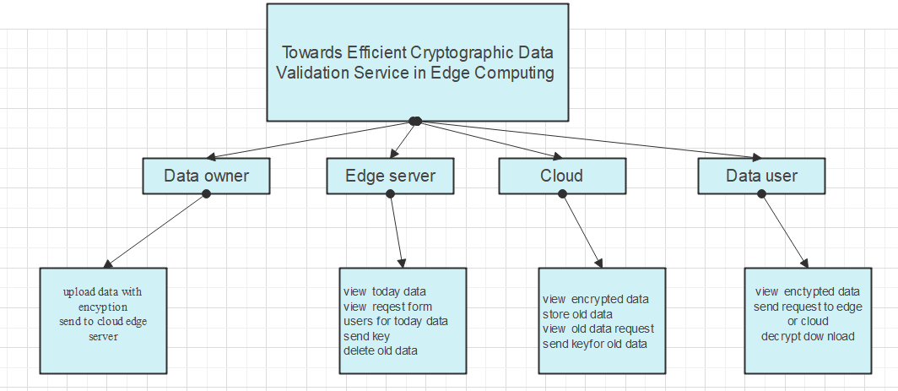
Concept Tree
(Tree Representation your concept hierarchy)

Slide 4
Problem Statement
Edge computing brings data computation and storage closer to the mobile device to save response time for decision making. After being processed at the edge, commonly the data will be uploaded to the cloud for further enriched analysis. For privacy concerns, local devices may encrypt the collected data before sending it to the cloud server. This treatment increases the server's processing time and makes it hard to pick out the desired data Mobile Edge Computing (MEC) is a technology that brings computing and data storage to edge servers in order to reduce the workload of network devices in applications such as 5G and 6G networks

Slide 5
Problem Statement
Existing Method:
In existing methods data is managed by cloud servers to store and handle request for user data where edge server is used to process data. To reduce time of data processing edge servers are used to process data without encryption which is not secure even time of data process is decreased security is compromised.
Disadvantages:
Security of data is compromised by improving process speed.
Data is not encrypted and edge servers are just used to process data.

Slide 6
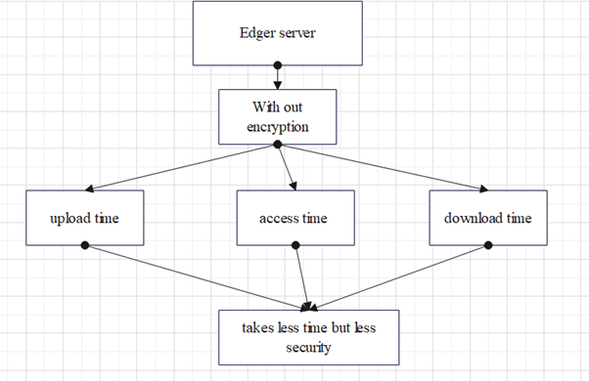
Problem Illustration

Slide 7
Proposed Method
In proposed method we are using edge computing to improve data security and save time to access data. In proposed system when owner uploads data to edge server , sever will handle one day data with encrypted data and give access to users with out involvement of cloud servers for respective day and delete data after access for that day from edge server, Edge server only gives access for that day data where are cloud sever provides access for old data. This process saves time and improves security by encrypting data using AES Algorithm.

Slide 8
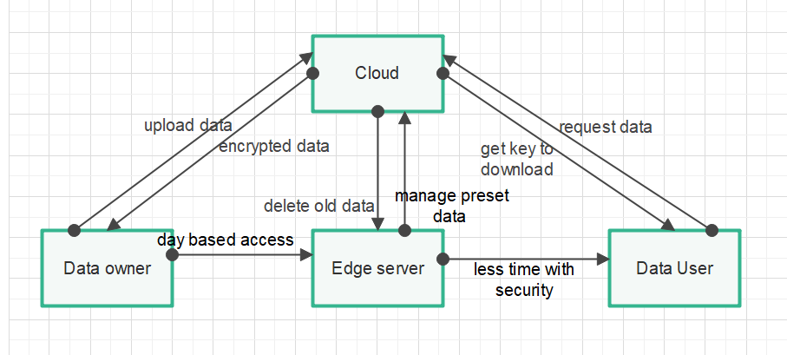
Proposed Method Illustration
request data

Slide 9
Experiment Environment
Development Environment:
Java : JDK 1.8
Netbeans IDE: 8.0.1 version
Mysql Workbench : 8.0 version
Hardware Requirements:
Processor: Intel Core i5/i5-2350M CPU @2.30GHz.
RAM Capacity: 4 GB RAM or more.
System Type: 64-bit Operating System.

Slide 10
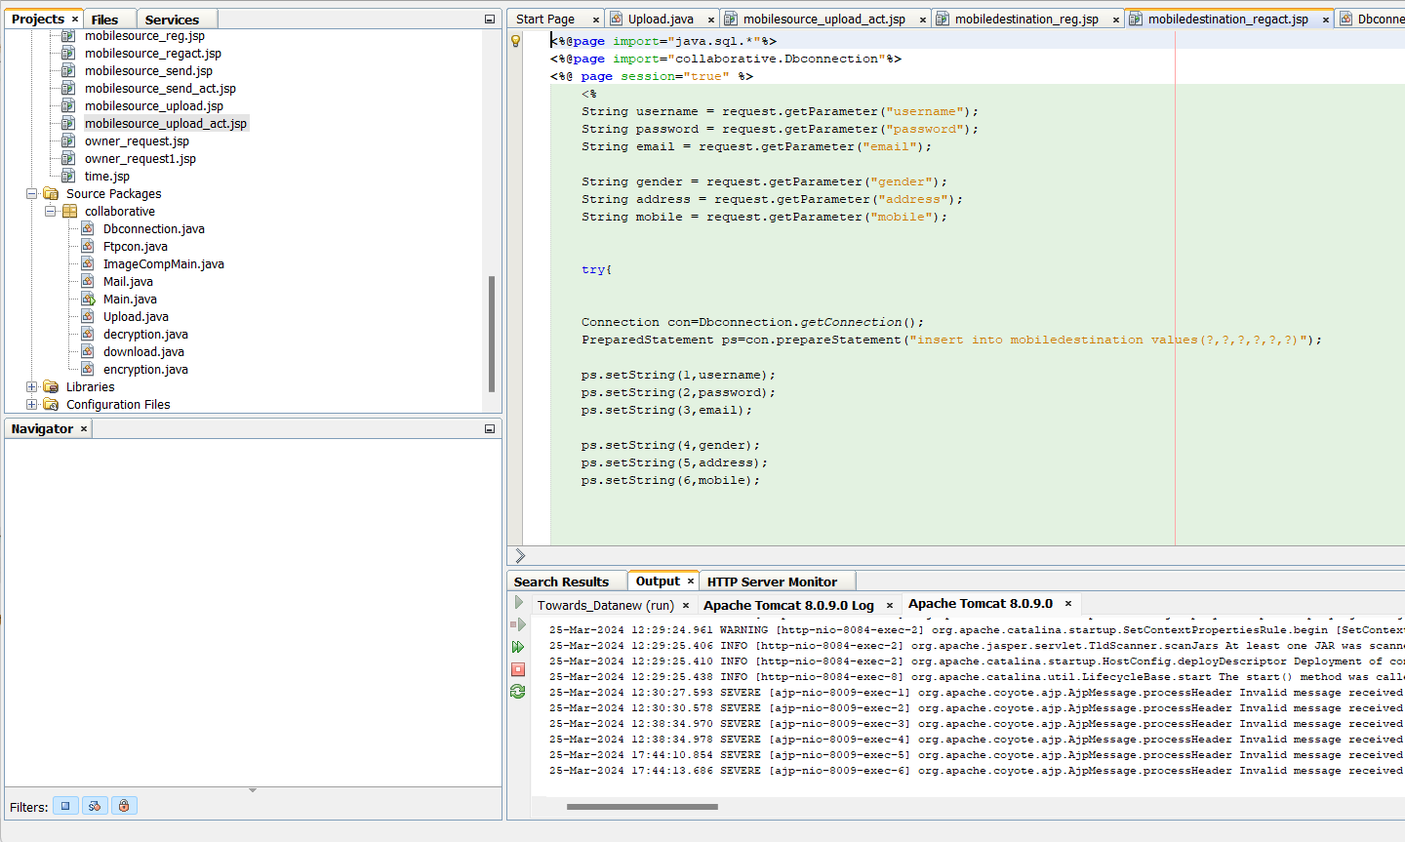
Experiment Screen shorts
Netbeans IDE

Slide 11
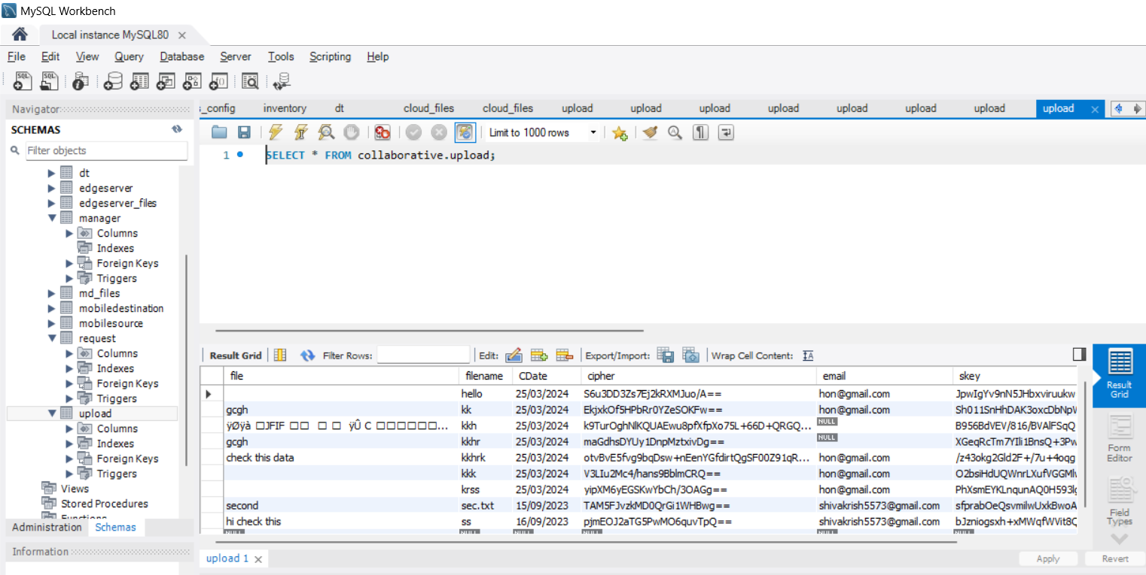
Experiment Screen shorts
MySQL Workbench

Slide 12
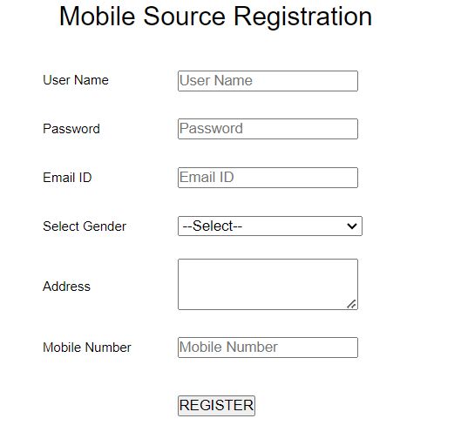
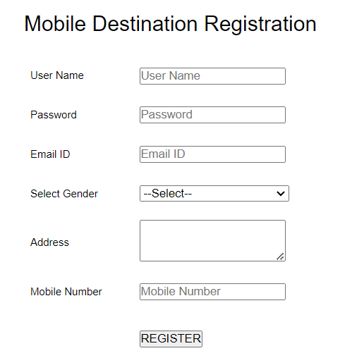
Experiment Results

Slide 13
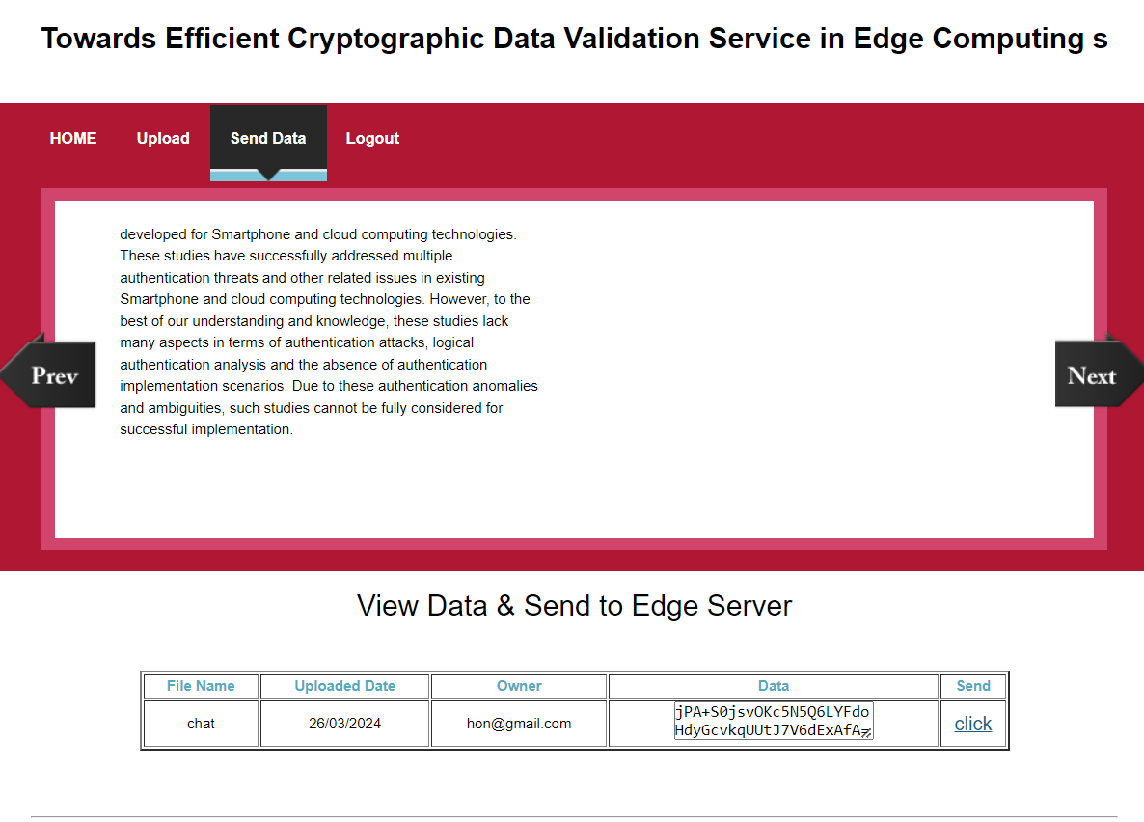
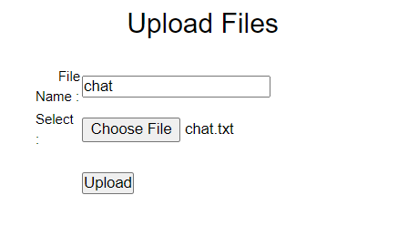
Experiment Results
Mobile source

Slide 14
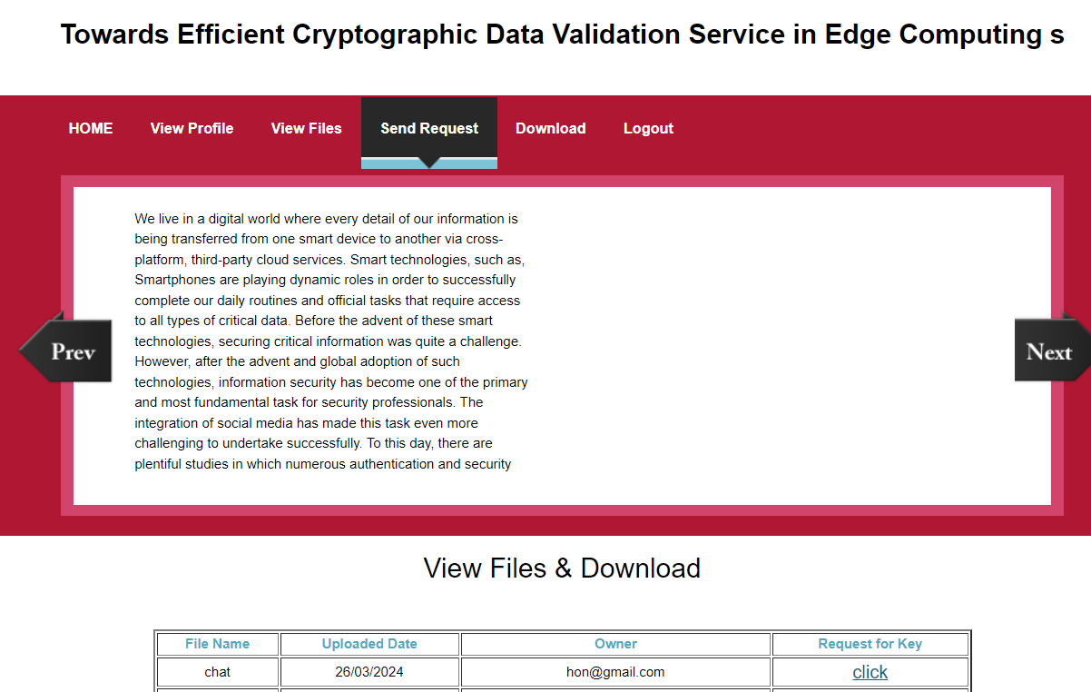
Experiment Results
Mobile Destination

Slide 15
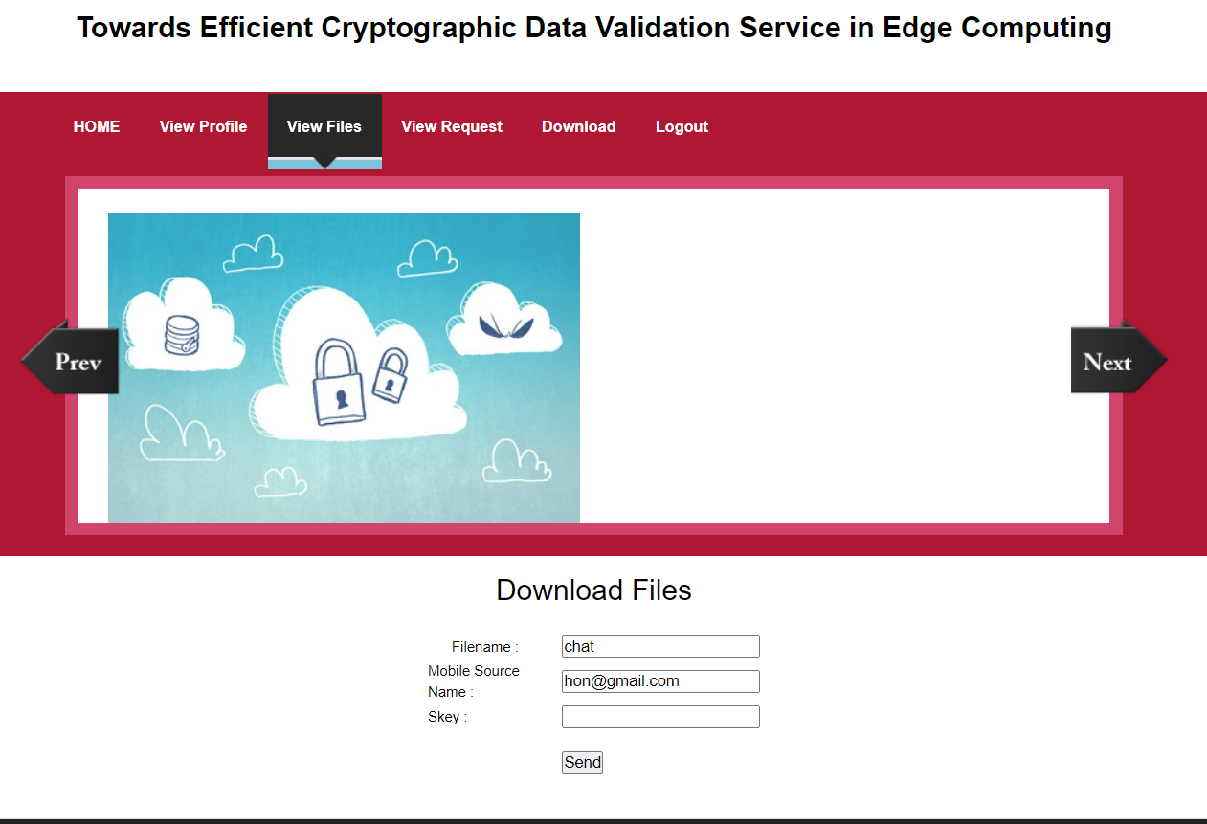
Experiment Results

Slide 16
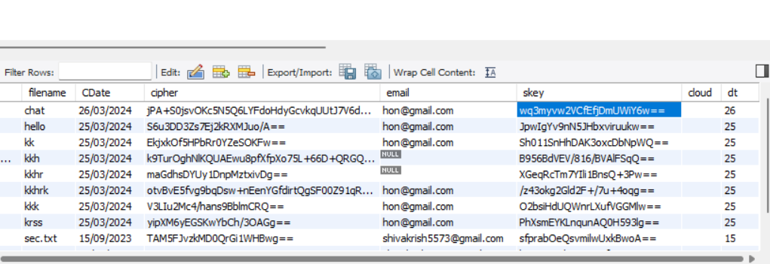
Experiment Results
Skey to Access the File

Slide 17
Finding
1. Cost :
Replicating data in edge systems incurs high storage costs due to storing multiple copies. Erasure coding disperses data in our key derivation procedure and the storage cost of the secret key is reduced from 547MB to 1.7MB.
2. Security
The data will be uploaded to the cloud for further enriched analysis. For privacy concerns, local devices may encrypt the collected data before sending it to the cloud server. By encrypting the data using AES algorithm .

Slide 18
Justification
The parameter each of selects now in lattice cryptography will directly impact the correctness and security of the proposed scheme. In this section, we show how to select appropriate parameters in our scheme. After specifying the parameter setting, we focus on analyzing the correctness in this part. And the security and data validations, analysis are presented. Edge server only gives access for that day data where are cloud sever provides access for old data. This process saves time and improves security by encrypting data using AES Algorithm.

Slide 19
THANK YOU

